Slide 1
DDoS Attack Detection
Using
Deep Learning
Jayesh V Jawade
121942010
1

Slide 2
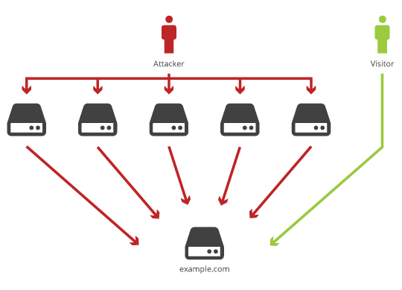
Introduction
Denial of Service (DoS)
Attack to disrupt the authorized use of networks, systems, or applications
Distributed Denial of Service (DDoS)
Employ multiple compromised computers to perform a coordinated and widely distributed DoS attack
2

Slide 3
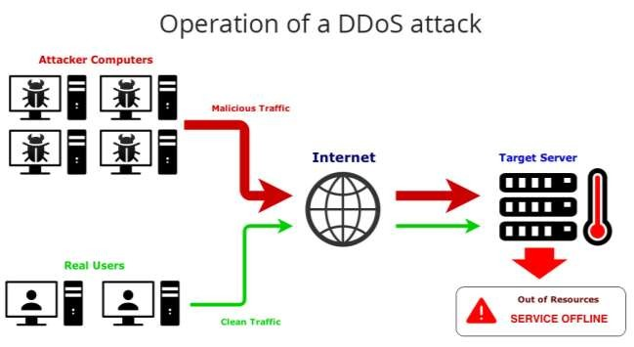
How DDoS Attacks Work
incoming traffic flooding the victim originates from many different sources – potentially hundreds of thousands or more.
effectively makes it impossible to stop the attack simply by blocking a single IP address;
very difficult to distinguish legitimate user traffic from attack traffic when spread across so many points of origin.
3

Slide 4
Our Approach
DDOS attack is very easy to detect when the network traffic is at high rate, but it’s equally hard to detect when the traffic rate is low and seems to be similar to legitimate traffic.
It is not enough to consider only the single packet or forward direction only to accurately detect attack.
Therefore, we implement the approach to detect DDOS attack based on Recurrent Neural Network (RNN).It is used to detect the repeated patterns representing DDOS attack and find them in a long traffic sequences.

Slide 5
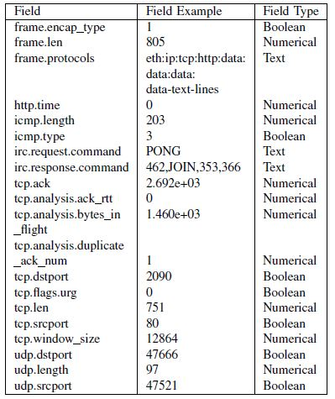
Implementation Details
Feature Extraction and Transformation
Dataset – ISCX IDS 2012
29 network traffic fields are present
in original dataset
20 network traffic fields are used for
implementation

Slide 6
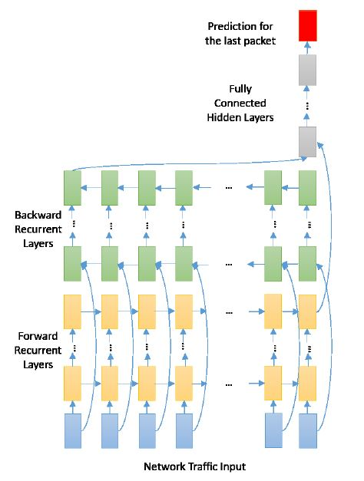
Implementation Details
Bidirectional Recurrent Neural Network
Recurrent Neural Network (RNN) :-
RNN are a type of Neural Network where the output from previous step are fed as input to the current step.
Long Short Term Memory(LSTM) :-
LSTM are a special kind of RNN, capable of learning long-term dependencies. LSTM model is used to remember information for long period of time. Hence, it is helpful to detect the DDOS attack from long sequence.

Slide 7
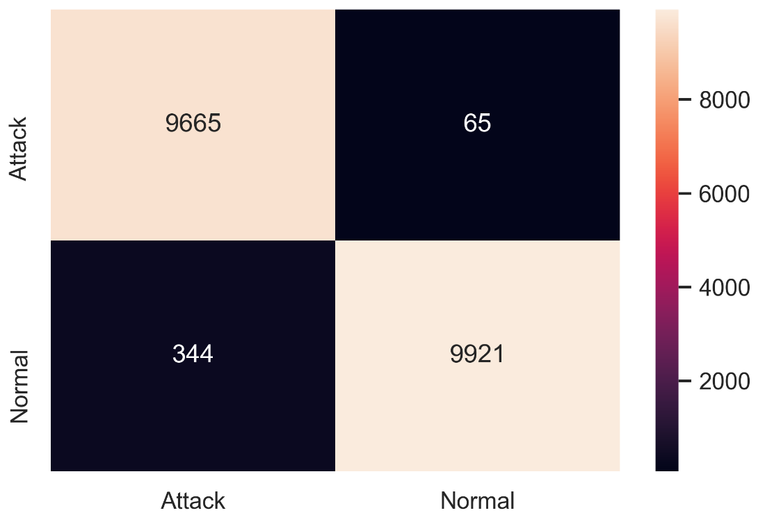
Outputs
Confusion Matrix :-
True Positive (TP) : Attack is performed and is correctly detected as attack.
b) True Negative (TN) : Attack is not performed and is correctly detected as normal.
c) False Positive (FP) : Attack is not performed but falsely detected as attack.
d) False Negative (FN) : Attack is performed but falsely detected as normal.
Fig : Confusion Matrix

Slide 8
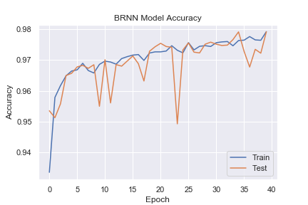
Outputs
Accuracy Model :-
Epoch :-
Because of using limited dataset, the computational power required for operation is less, which in turn reduce the time required for training without affecting its accuracy.
Fig : Accuracy Model

Slide 9
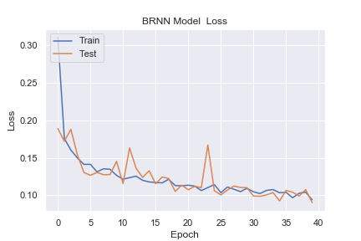
Outputs
Loss Model :-
As we increase the number of epoch, the model trains well and the accuracy increases and loss decreases.
Fig : Loss Model

Slide 10
Conclusion
The Recurrent Neural Network using bidirectional LSTM gives the accuracy of 98%
The accuracy of DDOS detection is increased by using the bidirectional LSTM model (Recurrent Neural Network in deep learning) by training the model on limited dataset (packets).
Because of using limited dataset, the computational power required for operation is less, which in turn reduce the time required for training without affecting its accuracy.
December 27, 2016
10

Slide 11
References
[1] X. Yuan, C. Li and X. Li, "DeepDefense: Identifying DDoS Attack via Deep Learning," 2017 IEEE International Conference on Smart Computing (SMARTCOMP), Hong Kong, 2017, pp. 1-8.
[2] Ali Shiravi, Hadi Shiravi, Mahbod Tavallaee, Ali A. Ghorbani, “Toward developing a systematic approach to generate benchmark datasets for intrusion detection” 2012 Elsevier Ltd.
11

Slide 12
Q/A ?
Thank You !
December 27, 2016
12

